Slide 1
CSS(Part II)
Web Development

Slide 2
Topics Covered
Box model
Style list, table and form

Slide 3
CSS Box Model
To control the layout of a web page, you need to understand the box model.
For display purposes, every element in a web page is considered to be a rectangular box.

Slide 4
CSS Box Model
top
To control the size of the element, use the height and width properties
You can set the width of padding, border and margin using CSS
margin
border
padding
left
element
right
bottom

Slide 5
Padding
The space around the content (inside the border) of an element
It is affected by the background colour of the element
You can set different padding for different sides:
padding-bottom : 10px;
padding-top : 5px;
Or use the shorthand property: padding : 25px 50px 75px 100px;
top
right
bottom
left

Slide 6
Border
Border properties:
border-width
border-style
border-color
p { border-width:3px; border-color:red;
border-style:solid; }
Shorthand property:
border : 5px dotted green;
order of value : border-width, border-style, border-color

Slide 7
border-radius Property
border-top-right-radius : 10%
border-bottom-right-radius:10px;
border-bottom-left-radius:10%;
border-top-left-radius:10px;
Shorthand:
Border-radius : 5px 10px 5px 10px;

Slide 8
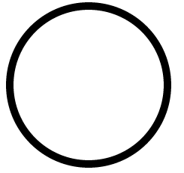
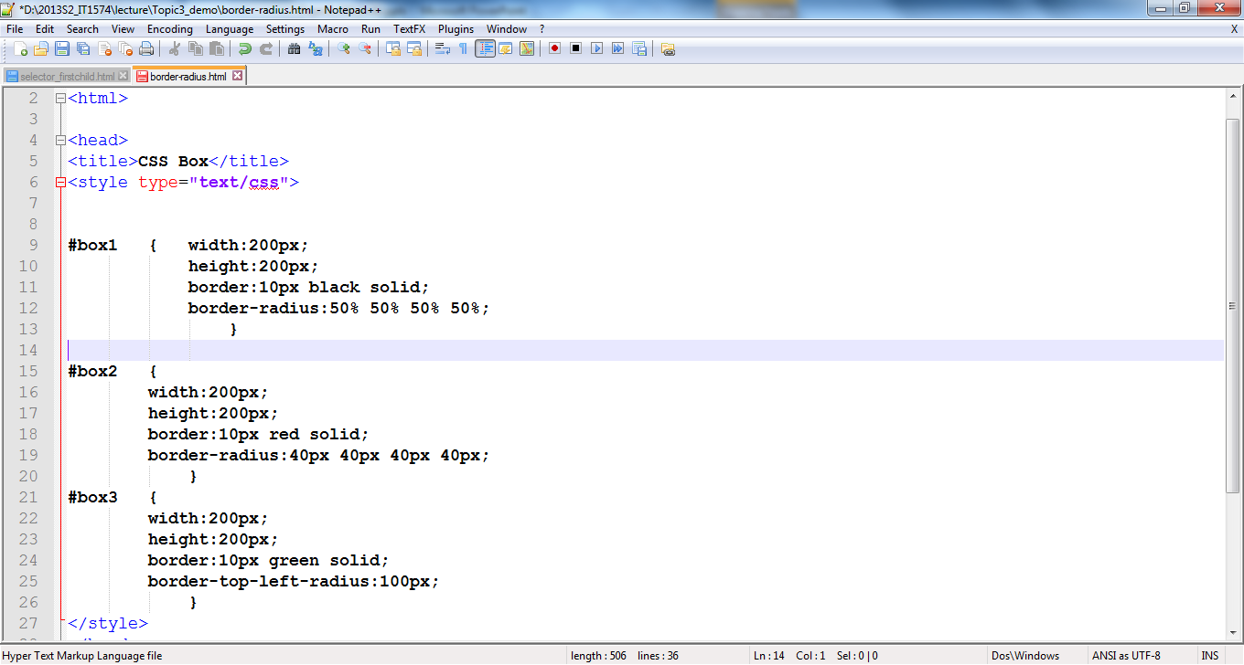
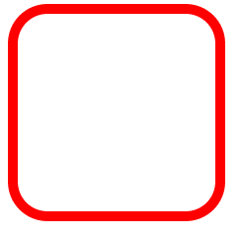
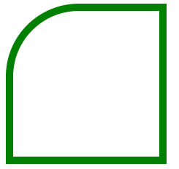
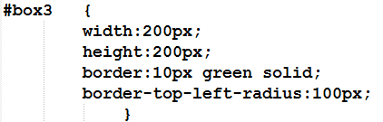
border-radius Property

Slide 9
Margin
The space around the content (outside the border) of an element
It does not have a background color, and is completely transparent
You can set different margin for different sides(similar to padding):
margin-left:20px;
margin-top:15px;
Or use the shorthand property: margin:25px 50px 75px 100px;
top
right
bottom
left

Slide 10
Margin
The margin determines the empty space between the element and any adjacent elements
Browsers often have default margin values
To center a box on the web page,
set the width of the box
set the left-margin and right-margin to auto

Slide 11
Float Property
The float property is used for positioning and formatting content e.g. let an image float left to the text in a container.
You can turn off the float by using the clear property
The clear property specifies which sides of an element other floating elements are not allowed
.clearme { clear : both;}
Notes:
The float property is used for positioning and formatting content e.g. let an image float left to the text in a container.
The float property can have one of the following values:
left - The element floats to the left of its container
right - The element floats to the right of its container
none - The element does not float (will be displayed just where it occurs in the text). This is default
inherit - The element inherits the float value of its parent
In its simplest use, the float property can be used to wrap text around images.

Slide 12
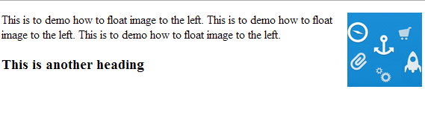
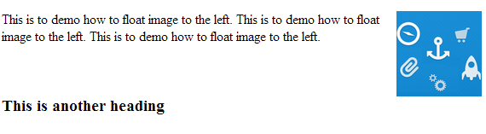
Float Property
The h3 text is displayed in normal flow.
clear: both; was applied to the h3. Now the h3 text displays AFTER the floated image.

Slide 13
Float Property
Property | Description | Values
clear | Specifies which sides of an element where other floating elements are not allowed | left right both none
float | Specifies whether or not a box should float | left right none

Slide 14
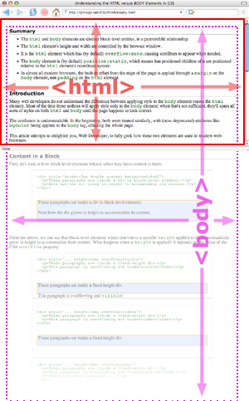
<html> vs <body>
<body> is the child of <html>
<html> height and width are controlled by the browser window
<html> overflow by default is auto
Source: phrogz.net/css/htmlvsbody.html
Example
Notes:
<body> of height or width 100% is relative to <html>. <html> of width and height 100% is relative to browser.

Slide 15
Overflow property
The overflow property specifies what happens if content overflows an element's box.
Visible (default, all content display regardless of size)
hidden (content out of border of element will not be displayed)
scroll (always have scroll bars)
auto (auto detect by browser whether it is necessary)
http://www.w3schools.com/cssref/pr_pos_overflow.asp

Slide 16
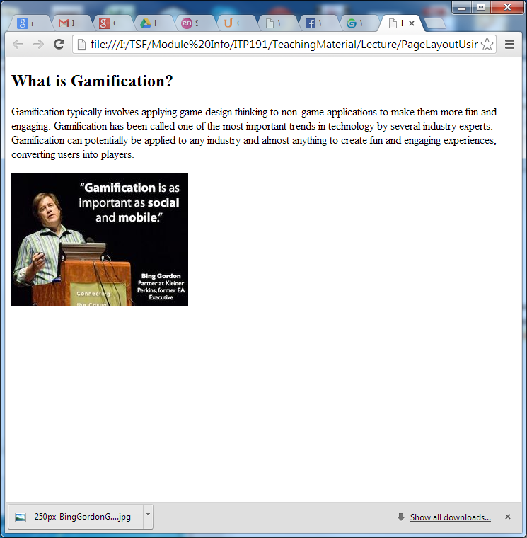
Block Element in Default Page Layout
A block element (e.g. <p>,<h1>, <Div>) takes up 100% the width of web page unless
The block element is given a width and
float is used

Slide 17
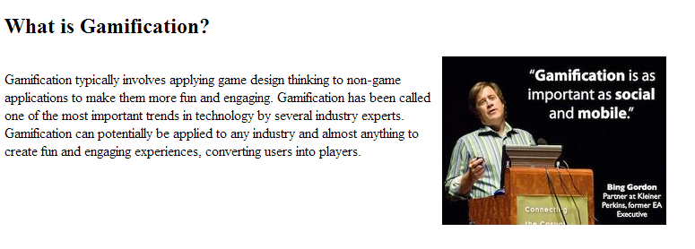
Block Element in Default Page Layout
<style>
p#gamification {
width:50%;
float:left;
margin-right:10px;
}
</style>

Slide 18
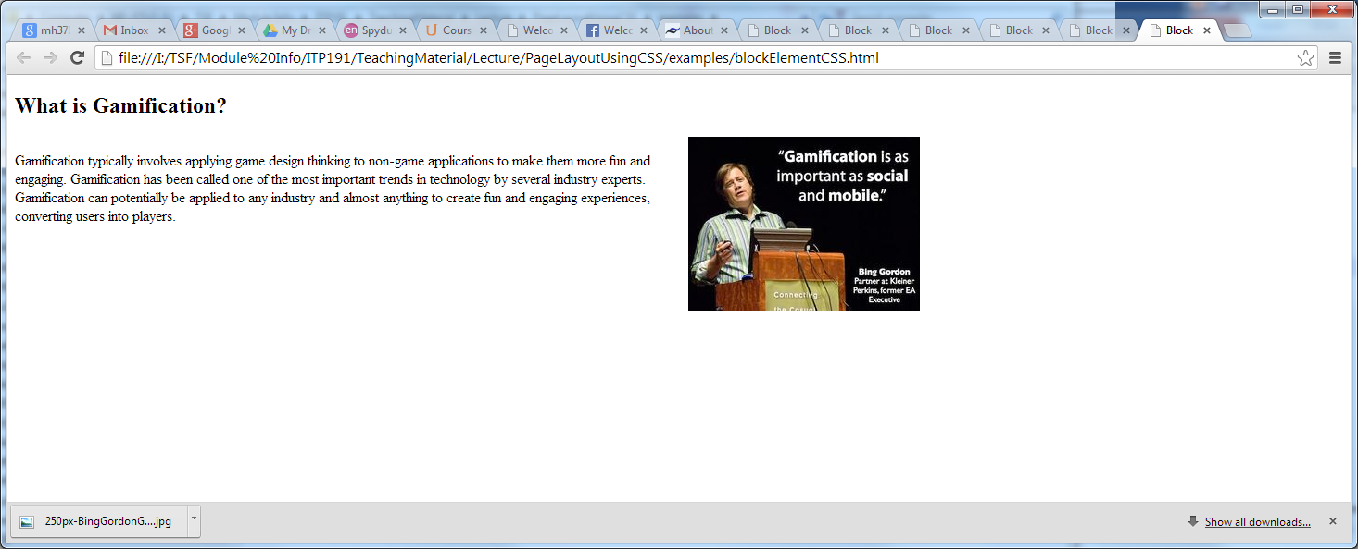
Width of Web Page
A web page by default takes up the width of the browser which is equivalent to 100%
When browser is being resized, content of web page behaves like “fluid” which make the most of the space available

Slide 19
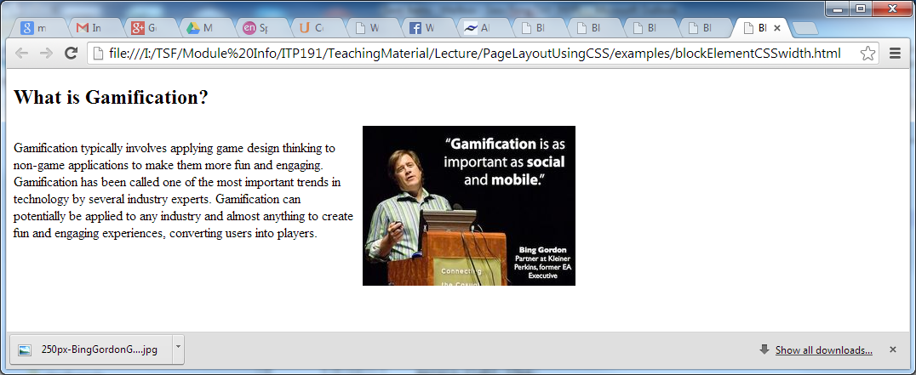
Width of Web Page
Setting the min-width and max-width CSS property of <body> will help in getting predictable and desirable appearance of page
body {
max-width:800px;
}
The maximum width of the content
800px

Slide 20
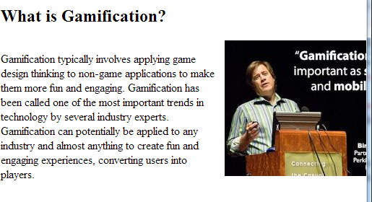
Width of Web Page
Setting the min-width and max-width CSS property of <body> will help in getting predictable and desirable appearance of page
body {
min-width:600px;
}
Two columns layout remains when browser width less than 600px
600px

Slide 21
Centralize Web Page
body {
margin: 0 auto;
}
top bottom
Left right
(depends on size of browser)

Slide 22
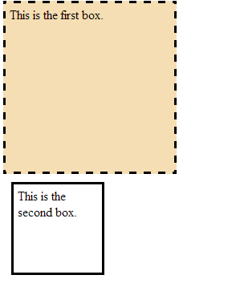
Normal Flow
Browser display of elements in the order they are coded in the Web page document
<div>
<p>This is the first box</p>
</div>
<div>
<p>This is the second box</p>
</div>
Two div elements

Slide 23
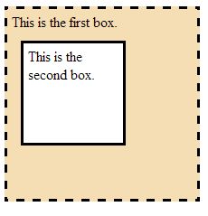
Normal Flow
Browser display of elements in the order they are coded in the Web page document
<div>
<p>This is the first box</p>
<div>
<p>This is the second box</p>
</div>
</div>
Nested div elements

Slide 24
Styling Lists, tables and forms

Slide 25
Styling a list: List specific styles
list-style-type: Sets the type of bullets to use for the list.
This can also be achieved by using type attribute (html5)
ul.main {
list-style-type:upper-roman;
}
list-style-position: Sets whether the bullets appear inside the list items, or outside them before the start of each item.
list-style-image: Allows you to use a custom image for the bullet, rather than a simple square or circle.

Slide 26
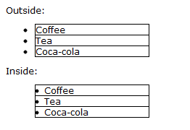
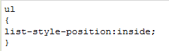
Styling a list: List specific styles
list-style-position: specifies if the list-item markers should appear inside or outside the content flow.
Source : w3schools.com

Slide 27
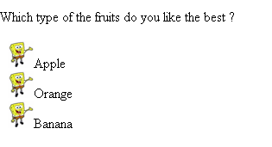
Styling a list: List specific styles
<html>
<head><title>The Image List Marker</title>
<style type="text/css">
ul {
list-style-image: url('images/sponge.gif')
}
</style>
</head>
<body>
<p>Which type of the fruits do you like the best ?</p>
<ul>
<li>Apple</li>
<li>Orange</li>
<li>Banana</li>
</ul>
</body>
</html>
list-style-image: specifies image bullets

Slide 28
Styling a Table
Border of table
border-collapse
value: collapse , separate (default)
Table, row(tr), cell(td,th) can be given width and height
Alignment of text inside cell
vertical-align
text-align
Text in cell can be styled with all font/text properties

Slide 29
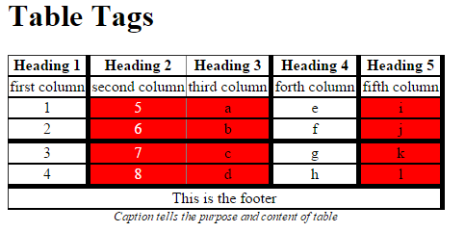
Styling a Table
table { border-collapse: collapse; }
tr { border-bottom: solid 2px }
colgroup { border-right: solid thick }
tbody { border-bottom:solid thick }
colgroup.red {background-color:red; }
thead { background-color:white; color:black}
tbody td:nth-child(2) {
color:white;
}
td { text-align:center }
caption {
caption-side:bottom;
font-style:italic;
font-size:0.8em;
}
Example:

Slide 30
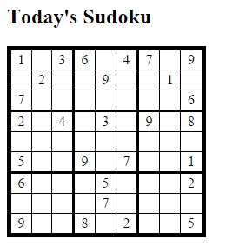
Styling a Table
table { border-collapse: collapse; border: solid thick; }
colgroup, tbody { border: solid medium; }
td { border: solid thin; height: 1.4em; width: 1.4em; text-align: center; padding: 0; }

Slide 31
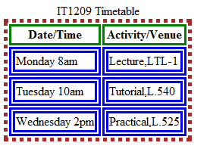
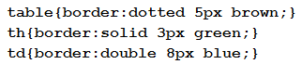
Styling a Table
By default, a table does not have a border
To can use border properties to set the width, color and style of the table border
Example:

Slide 32
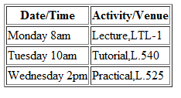
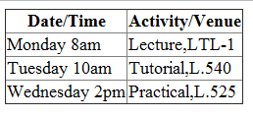
Styling a Table
By default, most browsers add space between borders of the neighbouring table cells and the outside border
You can use border-collapse property to remove the space
table {border-collapse : collapse;}

Slide 33
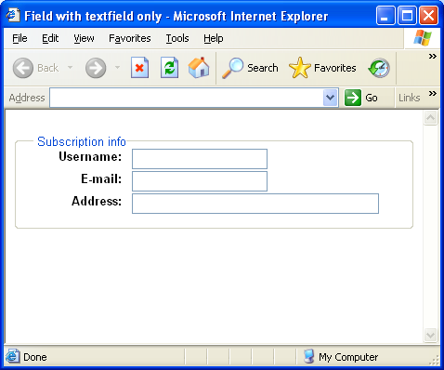
Styling a form
Styling fieldset and label
fieldset {
padding: 1em;
font-size:80%;
font-family:sans-serif;
}
label {
float:left;
width:25%;
margin-right:0.5em;
padding-top:0.2em;
text-align:right;
font-weight:bold;
}
show

Slide 34
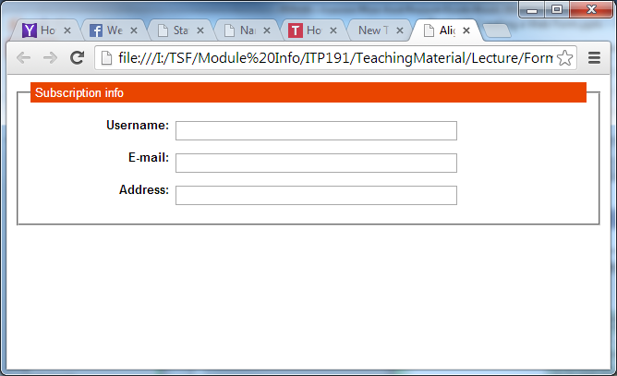
Styling a form
Styling fieldset and label
legend {
background-color:rgb(233,69,0);
color:white;
padding:3px 0px;
text-indent:5px;
width:100%;
}
input {
display:block;
float:left;
font-size:0.9em;
margin:7px 0px;
width:50%;
}
show

Slide 35
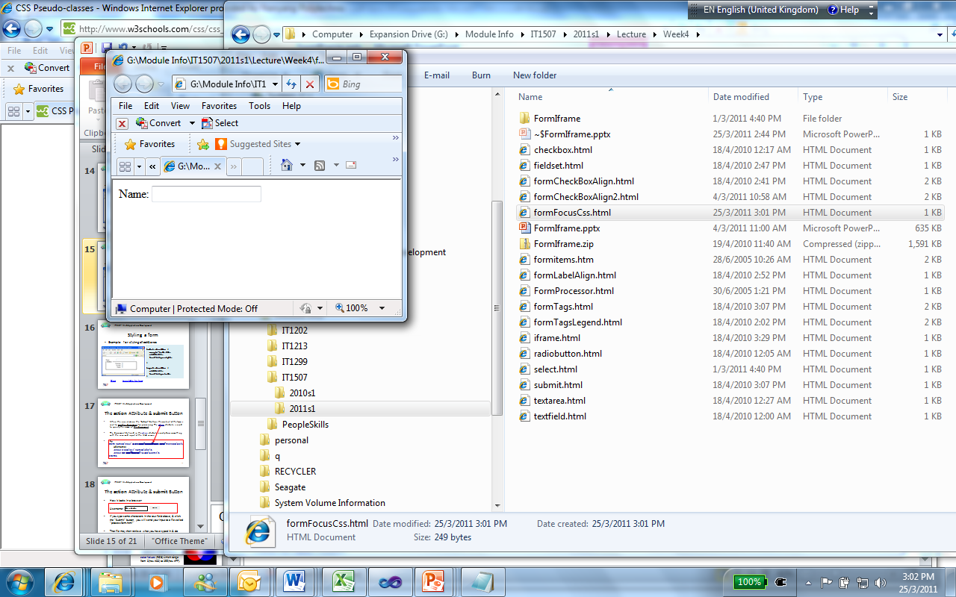
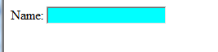
Styling a form
Change background color of a focus field
input:focus
{
background-color:cyan;
}
You may set a particular field be focused by
Adding an autofocus attribute to the field.
e.g. <input type=“text” autofocus="autofocus“/>
More to show

Slide 36
DISPLAY & Visibility PROPERTIES

Slide 37
Display property
Recap :
Inline element:
By default, inline element does not start on a new line
Examples:
<span>, <img>, <a>
Block element:
By default, block element starts on a new line
Examples:
<p>, <h1>,<table>,<ul>,<li>

Slide 38
Display property
display:none ;
The element will not be displayed.
display:block ;
The element is rendered as a block element even if it is actually an inline element
display:inline;
The element will be rendered as an inline element even if it is actually a block element

Slide 39
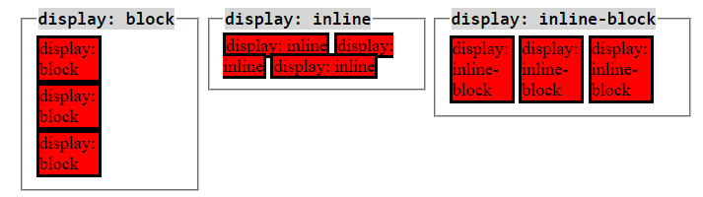
Display

Slide 40
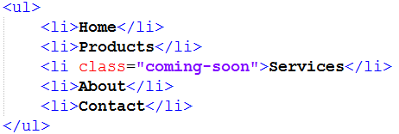
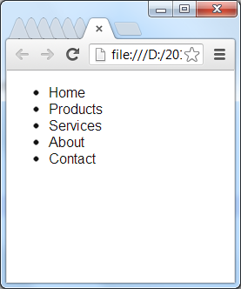
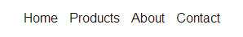
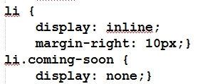
Display property
original html
Notes:
Demo display_start.html and display_end.html
With display set to none, Services disappear from the web page.
<li> now becomes an inline element

Slide 41
Visibility property
The visibility property hides the element and leaves a space where the element should have been
visibility:hidden;
The element is hidden.
visibility:visible;
The element is shown.
Notes:
Demo visibility.html

Slide 42
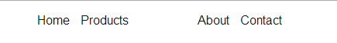
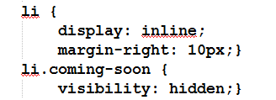
Visibility property
Notes:
Demo visibility.html

